Slide 1




CICTAMEX PROJECT
PROGRESS REPORT
September 24, 2025

Slide 2



BACKGROUND
CICTAMEX: a Mexican foundation, owner of an avocado variety collection (germplasm bank) facing problems and funding limitations
  Giovanni Cavaletto first introduced the problem/opportunity to MHAIA in January 2024
  At that time, it had a little less than 500 accessions, both wild and cultivated (other 300-plus had already been lost)
  An extremely valuable resource with a huge potential for the improvement and eventual survival of avocado farming
  A revised project was presented to and approved by the MHAIA Board in February 2025
  300K were allocated, from the Special Projects FY 2025 Budget
  250K were allocated for the FY 2026 in May 2025
  Main Project Objectives (Short Term)
  To preserve and safeguard the avocado germplasm bank owned by CICTAMEX, including the planting of a back-up collection in Michoacan
  To promote a managerially efficient and technically effective operation of CICTAMEX

Slide 3
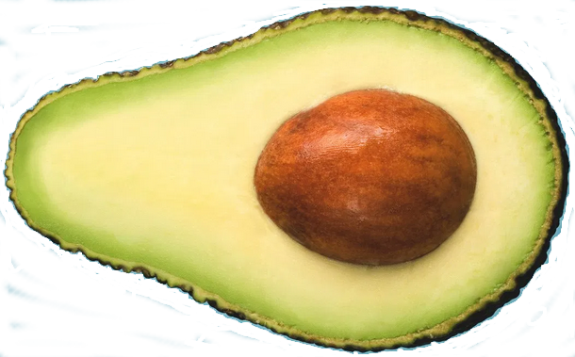
Project Objectives
  To preserve and safeguard the avocado germplasm bank owned by FSSC-CICTAMEX, including the planting of back-up collections in new locations (e.g., Michoacan, Jalisco)
  To promote the growth of the germplasm bank through exploration, search, collection, and evaluation of new materials
  To reactivate CICTAMEX’s research programs and to start new ones, aiming at using the genetic resources of the avocado germplasm bank to develop new commercial varieties and rootstocks, for the benefit of the Mexican avocado industry
  To secure the timely and correct registration of all property rights derived from the collection and research; safeguard them; and define the participation of APEAM and other potential sponsors in the benefits of the exploitation of such rights
  To promote a managerially efficient and technically effective operation of CICTAMEX, including sound processes of strategic and operational planning, effective leadership, efficient operation, and rigorous protocols of supervision and control
  To use some available resources of FSSC and CICTAMEX to develop economically productive activities (e.g., a nursery, a commercial avocado orchard, consulting and training services, etc.), the benefits of which could be reinvested in CICTAMEX’s programs

Slide 4
PROGRESS REPORT
A formal Collaboration Agreement between APEAM and CICTAMEX was signed on April 10, 2025
An Executive Committee was established
  3 members from APEAM
  3 members from CICTAMEX
  2 members from MHAIA
  The APEAM’s Chairman is also the Chair of this Executive Committee
  The Executive Committee has been meeting every month
  CICTAMEX presents quarterly budgets; upon approval, APEAM transfers funds on the same quarterly basis
  APEAM’s technical and financial staff closely supervise operations and fund use, respectively

Slide 5
PROGRESS REPORT
Maintenance and improvement of the germplasm bank
  The original orchard in Coatepec Harinas is now being efficiently farmed: weed, pest, and disease controls; fertilization and soil amendments; pruning; irrigation, etc.
  455 accessions were saved, plus 39 which are in danger; 354 hybrids and segregants were also saved
  Some Persea specimens were newly collected in Oaxaca, focusing on climate resilience
  The more recent plantation in Temascaltepec is also being efficiently farmed
  Scions were collected and a nursery to replicate the whole collection was established in Temascaltepec: There are 8-10 replicates of each accession, hybrid, or segregant. Five of them will be planted in Temascaltepec, and the remaining 3-5 will go to Michoacan
  APEAM is searching a good place to establish its back-up collection

Slide 6
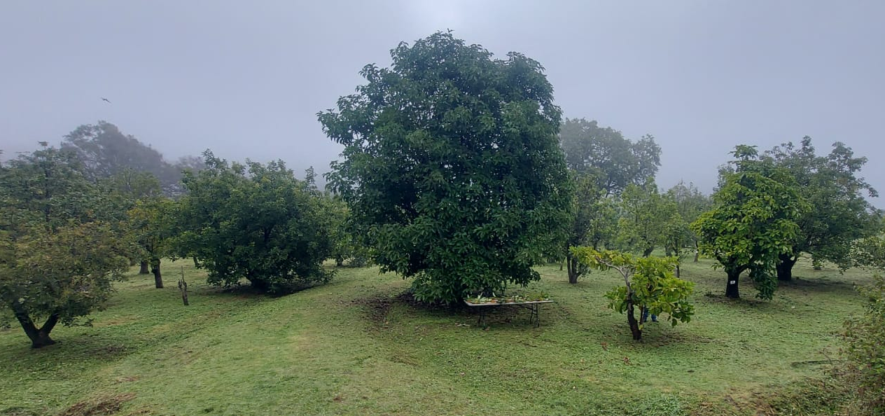
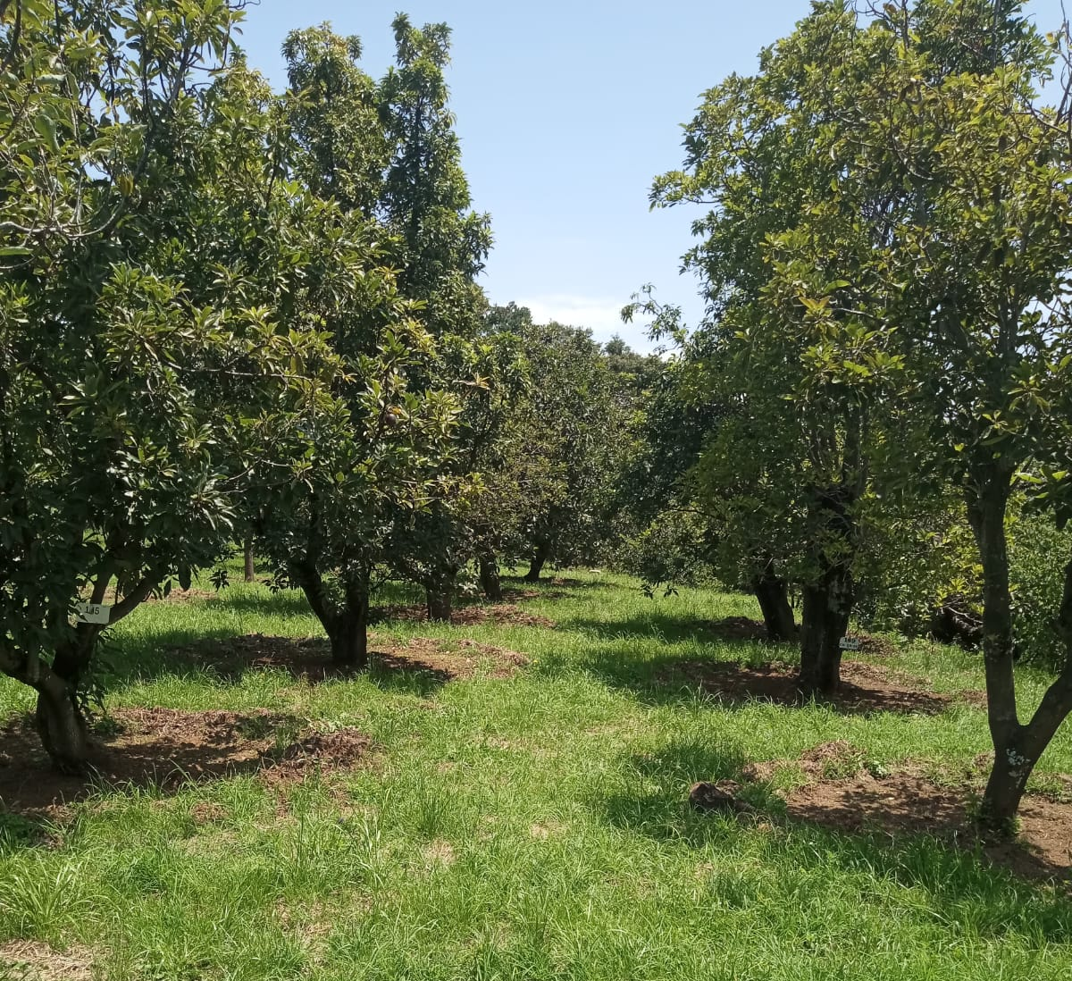
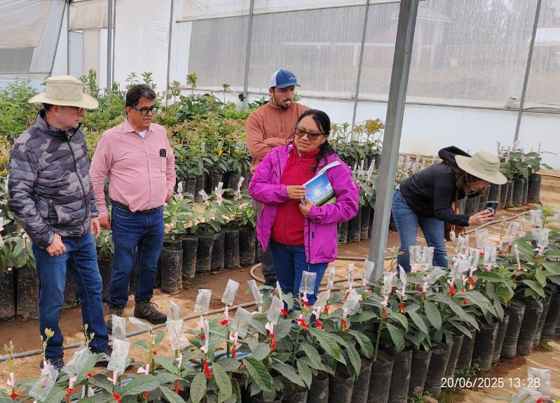
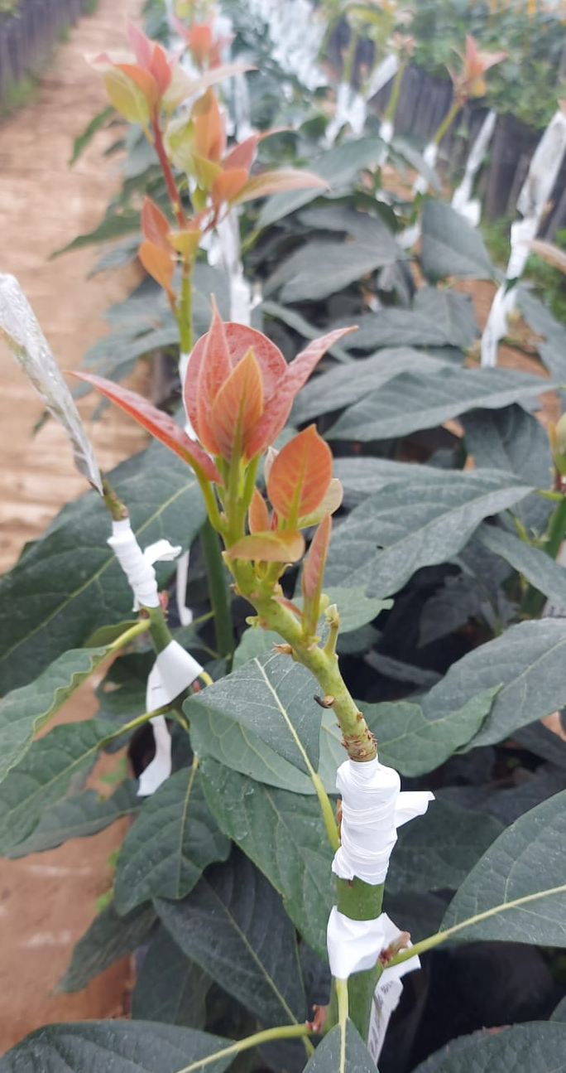
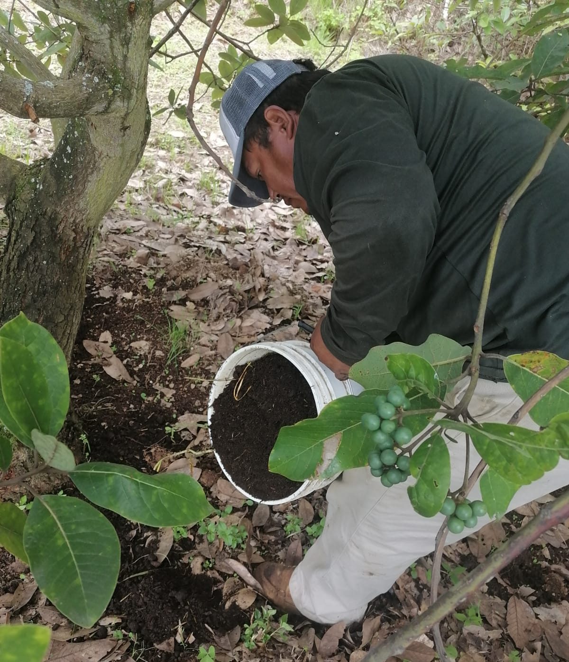
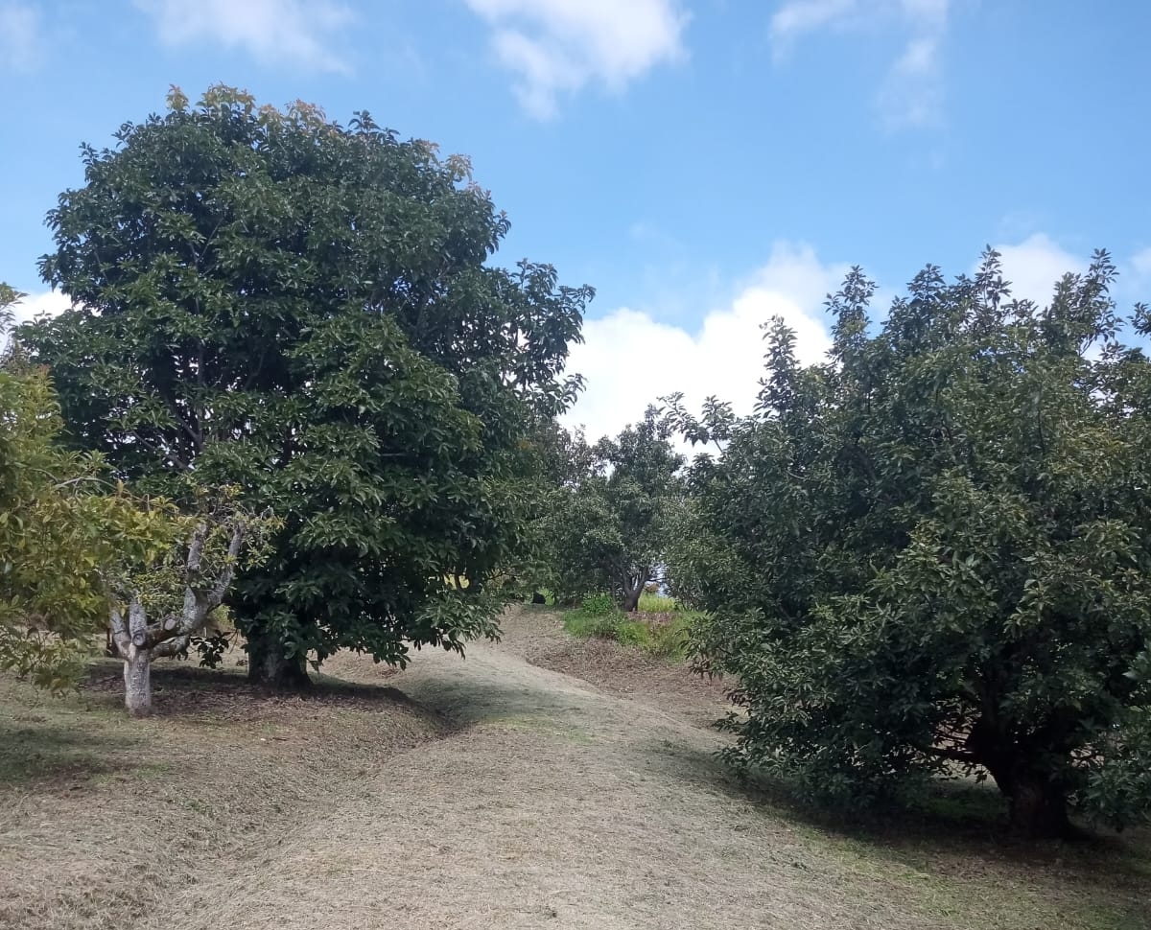

Slide 7
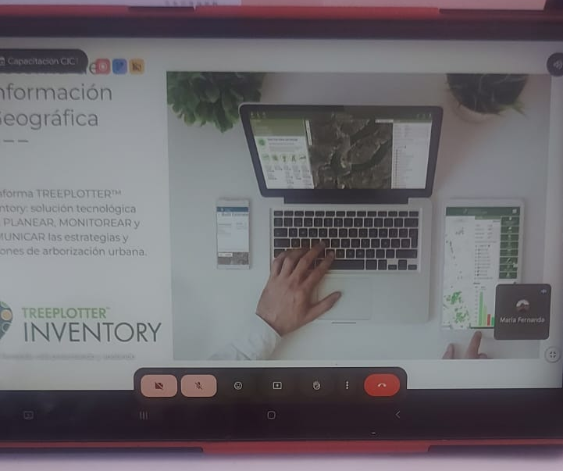
PROGRESS REPORT
Acquisition and implementation of the TreePlotter platform
  It allows to have an inventory with the GPS location of each tree in the germplasm bank
  A description and relevant data of each tree can be stored in the platform

Slide 8
PROGRESS REPORT
A “Strategic Business Plan 2025-2030” is being developed, with the support of an agri-business consulting firm (Innovagro)
  To be completed in February 2026, with a cost of $22,000 + VAT
  Includes: (a) Organizational assessment and SWOT analysis; (b) Strategic definition and alignment; (c) Identification and selection of strategic programs and projects; (d) Implementation of an efficient model of financial management; and (e) Control and reporting plan, including the design of a Balanced Scorecard and KPIs
  A detailed Operational Plan for 2025 and 2026 is also included
A long term “Scientific Plan” will soon be developed
  Definition of the the best way to preserve the germplasm and use its materials to eventually obtain improved rootstocks and commercial varieties
  Integrated into the industry’s “Path to Sustainability” environmental strategy, as a crucial component of the biodiversity of avocado species and a source of the crop’s resilience to climate change and global warming

Slide 9
BUDGET UPDATE
Budget for the 2025 FY (300K)
  157,615 have been invested; a balance of 142,385 remains
Budget for the 2026 FY (250K)
  To be executed in the period January-December 2026

Slide 10

Thank you!

